Slide 1


YOUR QUALITY PARTNER FOR SOFTWARE SOLUTIONS
5G Radio Access Network
Sierra Wireless Validation Team
TMA Solutions
www.tmasolutions.com

Slide 2
Agenda
LTE RAN Architecture Recall
NR RAN Architecture
3GPP Function Split in NR RAN
CP-UP Function Split in NR RAN
NGFI and Small Cell Function Split
Q & A

Slide 3
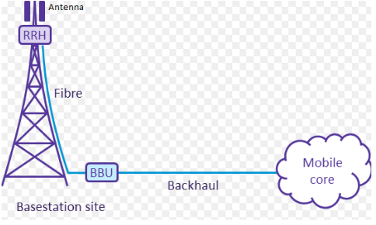
LTE RAN Architecture
Notes:
Convert optical signal to electrical signal and vice versa using CPRI
In transmitter section of RRH, it convert digital signal to RF and amplifies that signal to the desire power level and Antenna connected to it, radiates the RF signal in air
In Receiver section of RRH, it receives the desired band of signal from antenna and amplify it.
And convert RF signal back to digital signal in the receiver chain.

Slide 4
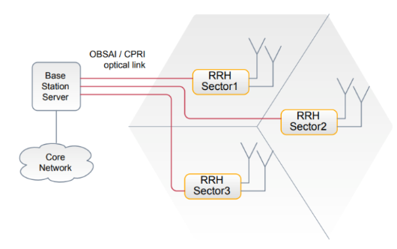
LTE RAN Architecture(cont)

Slide 5
Weakness of current LTE RAN
The major bottlenecks of CPRI are its high bandwidth and low latency demand such as when using in LTE systems, and is struggling to support next generation C-RAN.
CPRI and OBSAI are fixed rate interfaces based on TDM that transmit information during offload resulting low resource utilization.
The raw 𝐼𝑄 samples transmitted between RRHs and BBUs consume too much bandwidth of the transport network. Solutions such as reducing signal sampling rate, applying non-linear quantization, frequency sub-carrier compression and 𝐼𝑄 data compression
Notes:
The advantages of C-RAN is limited by the properties of the link that connects central unit to the remote radio unit. The link is termed as fronthaul link. Existing fronthauls use CPRI or OBSAI interfaces. However, the major bottlenecks of CPRI are its high bandwidth and low latency demand such as when using in LTE systems, and is struggling to support next generation C-RAN. Further, in contrast to dynamic features of mobile services, CPRI and OBSAI are fixed rate interfaces based on TDM that transmit information during offload resulting low resource utilization.
The current widely used interface protocol for In-phase (𝐼) and Quadrature (𝑄) data transmission between RRHs and BBUs is Common Public Radio Interface (CPRI) [4]. The estimated 𝐼𝑄 data throughput exceeds 10 Gbps for a 3 sector Base Station (BS) with 20 MHz 4×4 MIMO. A BBU pool which connects 10-1000 BSs will need vast transmission bandwidth in The fronthaul [5], which is one of the main issues of C-RAN.

Slide 6
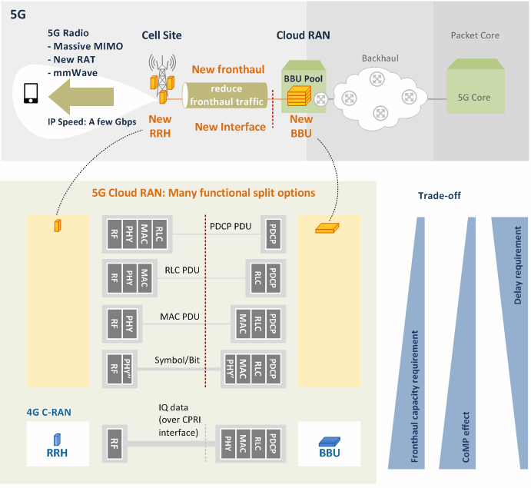
Comparison of NR RAN and LTE RAN

Slide 7
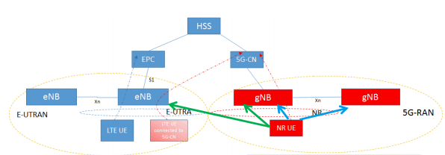
NR RAN Architecture

Slide 8
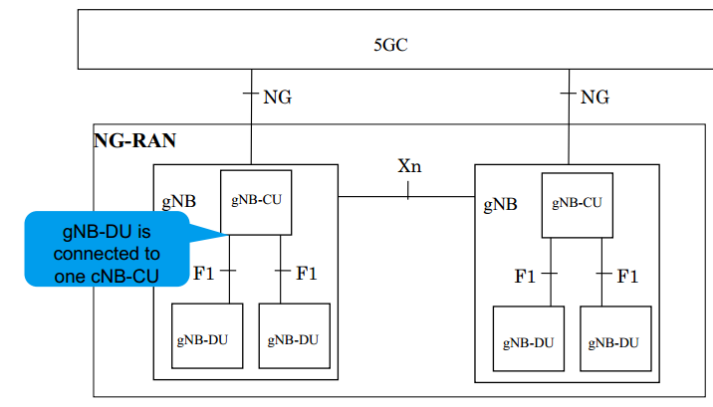
NR RAN Architecture(cont)

Slide 9
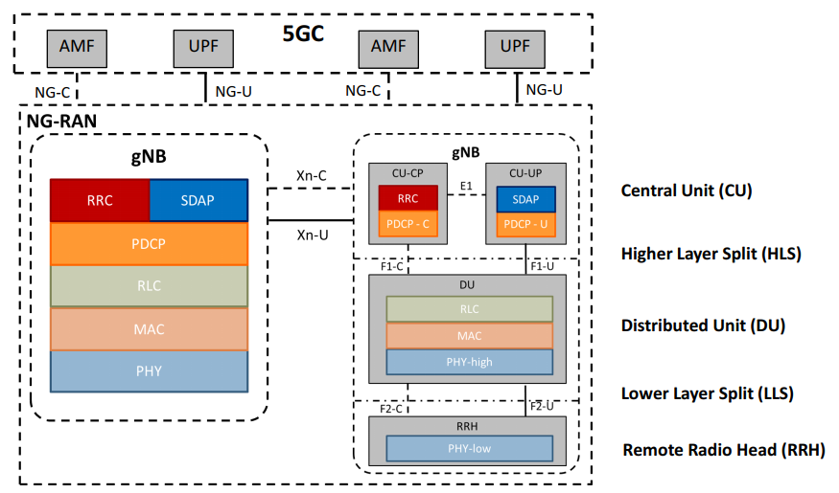
NR RAN Architecture(cont)

Slide 10
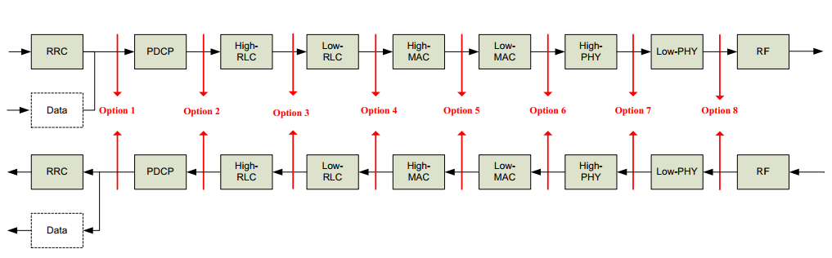
3GPP Function Split between CU and DU
Notes:
Figure 1 shows recommended functional splits between the central unit (CU) and distributed unit (DU) for E-UTRA, with a provision that the final conclusion may need to be revised for new radio (NR) once it is defined. Factors related to radio network deployment scenarios, constraints, and intended supported services such as supporting specific QoS settings per offered services (e.g., low latency, high throughput), user density and load demand per given geographical area to address the degree of RAN coordination, and transport networks with different performance levels (e.g., ideal and non-ideal) define the choice of NR functional split in the architec

Slide 11
Throughput and latency requirement Outcome
Throughput requirement: As split options are chosen at from a higher to a lower layer, i.e. from the split option 2 to option 8 (i.e., PHY/RF split option), the demand of BW requirement increases, with the lowest for option 2 and the highest for option 8.
Latency requirement: Split options 6 and above demand tight latency requirement, whereas split options 4 (i.e., RLC/MAC split option) and below demand loose, with option 5 (i.e., intra-MAC split option) unclarified.

Slide 12
Benefits of RAN Spilt Architecture
Flexible HW implementations allows scalable cost-effective solutions
A split architecture (between central and distributed units) allows for coordination for performance features, load management, real-time performance optimization, and enables NFV/SDN
Configurable functional splits enables adaptation to various use cases, such as variable latency on transport
Notes:
Reduced cost,
Improved scalability,
More efficient inter-cell coordination for interference management, and
Improved mobility in ultra-dense deployments.

Slide 13
CU-DU split function application
Support of specific QoS per offered services (e.g. low latency, high throughput)
Support of specific user density and load demand per given geographical area (which may influence the level of RAN coordination)
Availability transport networks with different performance levels, from ideal to non-ideal
Application type e.g. Real-time or Non- Real Time

Slide 14
3GPP aforementioned granularity options
Per CU: Each CU has a fixed split, and DUs are configured to match this.
Per DU: Each DU can be configured with a different split. The choice of a DU split may depend on specific topology or backhaul support in a given area.
Per UE: Different UEs may have different service levels, or belong to different categories, that may be best served in different ways by the RAN (e.g., a low rate IOTtype UE with no need for low latency does not necessarily require higher layer functions close to the RF).
Per bearer: Different bearers may have different QoS requirements that may be best supported by different functionality mapping. For example, QCI=1 type bearer requires low delay but is not SDU error sensitive,
Per slice: It is expected that each slice would have at least some distinctive QoS requirements. Regardless of how exactly a slice is implemented within the RAN, different functionality mapping may be suitable for each slice.

Slide 15
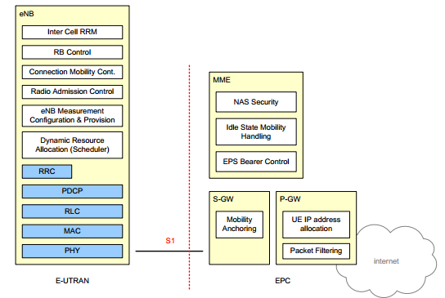
Function Split Between EUTRAN and EPC
Notes:
A centralization of CP functions, controlling different transmission points, has the
potential to achieve enhanced radio performance.
- Flexibility to operate and manage complex networks, supporting different network
topologies, resources and new service requirements.
- For functions purely handling with CP or UP processes, independent scaling and
realization for control and user plane functions operation.
Support of multi-vendor interoperability.

Slide 16
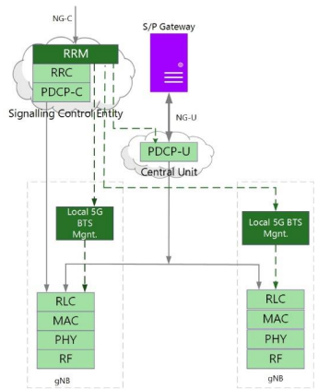
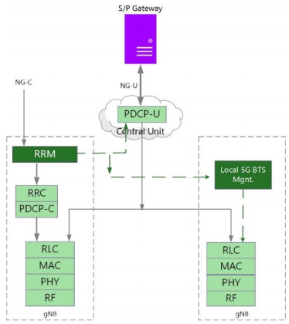
Centralized CP UP
Notes:
- Move the PDCP to a Central Unit while keeping RRM in a master cell.
- Move RRM to a more central location where it has oversight over multiple cells; while
allowing independent scalability of user plane and control plane.
- Central RRM with local breakout of some data connections of some UEs nearer (or at) the
base station site.

Slide 17
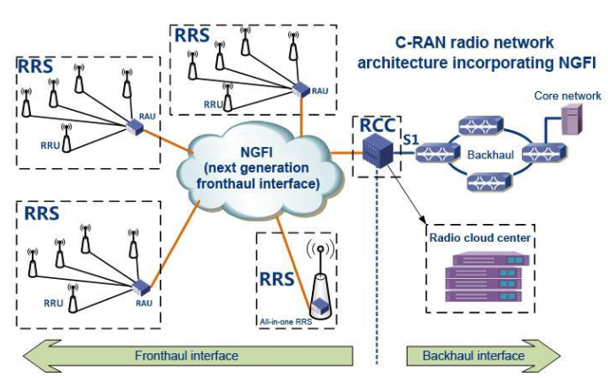
NGFI Functional Split Options

Slide 18
Changing from LTE RAN to NR RAN
It shifted some functionalities in BBU to remote radio head (RRH) such that the modified BBU and RRH are termed respectively as radio Cloud Center (RCC) and Remote Radio Systems (RRS).
The front haul network changes from point-to-point to multiple-to-multiple front haul network.

Slide 19
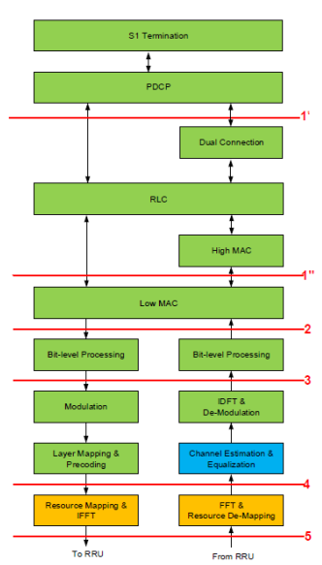
Division Plans for the RCC-RRS Interface

Slide 20
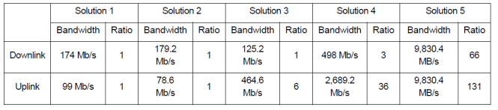
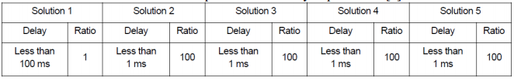
Comparison of the peak bandwidth and delay requirement
Notes:
BW requirement - Highest BW requirement for the fronthaul requirement for both uplink and downlink is option 5 - Lowest BW requirement for the fronthaul requirement for downlink is option 3 - Lowest BW requirement for the fronthaul requirement for uplink is option 2 - Optimum (summation of uplink and downlink) BW requirement for the fronthaul requirement is option 2 Delay requirement - Lowest delay requirement is option 1, i.e. 100 ms - All other options for splitting has the same delay requirement of less than 1 ms Analysis - From both BW and delay requirement perspectives, the Optimum split is option 2 (MAC/PHY Split) when considering aggregate BW requirement from uplink and downlink - For others (CoMP, RRS complexity, fronthaul interface complexity, pooling gain, the complexity of upgrading and maintenance, and iteration receiver), option 5 provides the best performances of all.

Slide 21
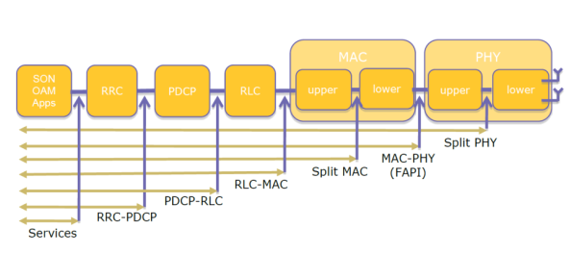
SMALL CELL Forum Functional Split

Slide 22
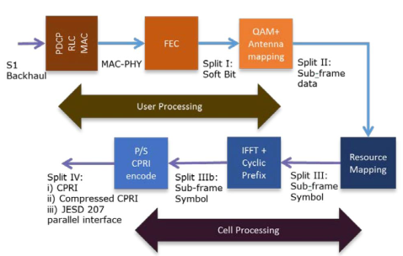
PHY layer Split recommendation
Notes:
From Table 5, use cases (splits) up to the MAC-PHY split have similar bandwidth requirements (i.e., 151-152 Mbps for DL and 48-49 Mbps for UL). However, for each PHY split, the bandwidth requirements increase significantly, i.e. 173Mbps for split I to 2457.6 Mbps for split IV in the DL. The similar trend can be seen in Table 3 for the UL for the throughput requirement.

Slide 23
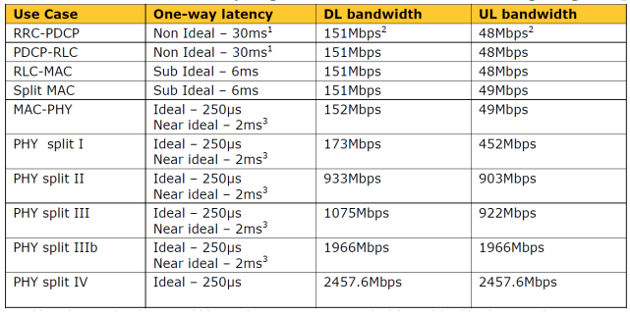
Bandwidth and latency requirements for each functional split option
Notes:
For latencies, the requirements for split options can be shown in three groups as follows. - RRC-PDCP and PDCP-RLC (non-ideal with 30 ms) - RLC-MAC and split MAC (sub-ideal with 6 ms), and - MAC-PHY and PHY split (ideal with 250 micro seconds or near-ideal with 2 ms). From the above Table 5, it can be considered that Split MAC or MAC/PHY could provide better performances in terms of both throughput and latency requirements with a view to shifting majority of the function to the central small cell.

Slide 24

Q&A

